Slide 1
MHV + VA.gov Health “Apartment” Q&A

Slide 2
Contents
Introduction: Co-creating a health vision
Why: Defining the problem space
What: Concepts for the future health experience
How: Work incrementally
Questions and Answers

Slide 3
Co-creating a health vision
INTRODUCTION
A bit of context
OCC and OCTO leadership identified a need for our offices to co-create a health vision. We committed to working together because:
We’re stronger together
A unified digital experience benefits Veterans
In April, we kicked off a series of workshops that aimed to create this vision. The workshops focused on why we need a vision, what the vision proposes to do, and how that might be done.

Slide 4
Defining the problem space
WHY
Veterans want a unified health experience
We did generative research with Veterans and caregivers to understand how they think about and experience health care at the VA.
We learned that Veterans are feeling some pain with the current health ecosystem.
Theme 3.2 – Participants had difficulty with the fragmented experience between MHV, eBenefits, and VA.gov. The fragmented experience is inaccessible for Veterans with cognitive disabilities.
Theme 3.3 – Participants struggled to complete health tasks whenever those tasks took them outside MHV. This included copay, travel pay, and scheduling appointments.

Slide 5
“Hide the plumbing”
WHY
Team brainstorm on what success looks like
One user experience ​
"Elimination of duplication of tasks"​
"One place to communicate to Veterans"​
One VA​
"Veterans do not need to know that we are several different teams. To them, their digital interactions feel created by the same VA."​
Personalized experience for all benefits​
"There are clear connections between health and benefits... How does my service history affect my disability rating, health care?"​

Slide 6
Concepts for the future health experience
WHAT
Background
OCC and OCTO leadership evaluated ideas for how to “hide the plumbing” and connect health with other VA benefits. All the concepts:
Would improve the Veteran health experience
Would make My HealtheVet’s and VA.gov’s designs more similar
Would have the My HealtheVet (MHV) and VA.gov teams working together more closely
Could result in more shared technology, infrastructure, and funding between MHV and VA.gov
Leadership evaluated the concepts based on 1) how well each concept supported specific top tasks/scenarios, and 2) which concept best fits user needs.

Slide 7
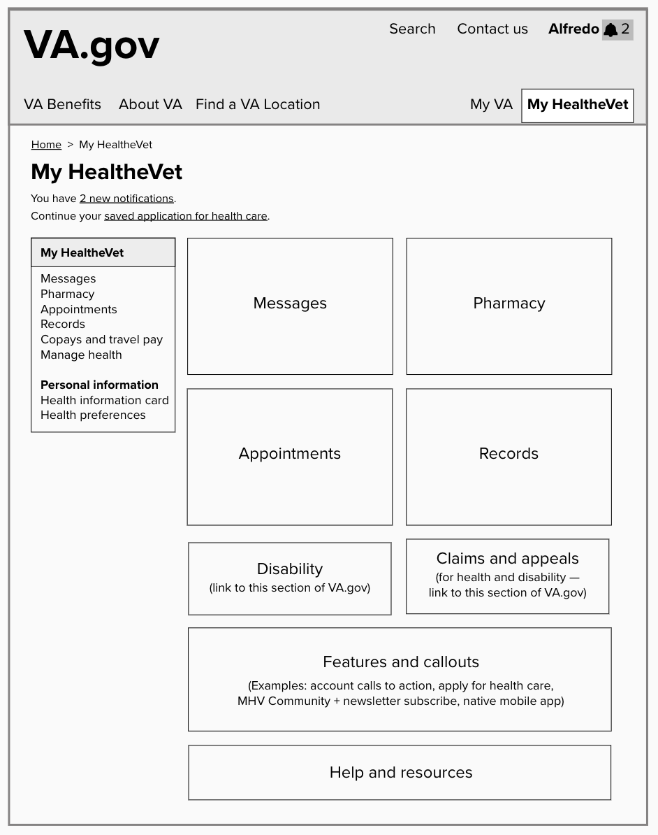
There was consensus on the “health apartment”
WHAT
Centralized notifications (health and other types).
Personalized content when you sign in.
Links to health-related content (e.g., disability, claims, travel pay).
Health things would live in a new section of VA.gov:
MHV content and tools
VA.gov health content and tools
Feature spots for calls to action or new functionality.
Help and resources specific to health.
Here’s a rough idea of how the “apartment” might look.

Slide 8
Work incrementally
HOW
planned
intended
envisioned
Notes:
Planned: Build the apartment section on VA.gov. Link users elsewhere for most products (ex., Messages links back to MHV), but move Appointments in right away since it’s already on VA.gov and therefore low-effort way to validate.
Intended: Assuming this goes well, we intend to move or rebuild Messages, Pharmacy and Records in the VA.gov MHV health apartment. After a soft launch and beta testing, MHV would direct users to the VA.gov MHV health apartment for these functions.
Envisioned: All health things in the MHV apartment on VA.gov. As you might imagine, this encompasses a lot. This vision will be our North Star for future health product decisions.

Slide 9
Planned work
HOW
Make sure the vision is viable before moving products.
OCTO is hiring a team to design and build the “apartment” section on VA.gov. No functionality will be moved from MHV at this time. For example, clicking “Messages” in the apartment will redirect the user to MHV. One OCC engineer and one OCC product person will lead this team, along with a designer from OCTO.
John Murphy and Lauren Alexanderson are creating a plan to consolidate web appointments around VAOS. This will be the first tool to move into the apartment.
The VA.gov team is already working on sitewide notifications, a key benefit of the health apartment.
Evaluate and learn. What went well? What did not? Should we adjust the vision?
Notes:
Handhold over handoff

Slide 10
Intended work
HOW
Some work needs more planning and validation before it’s actionable.
Adopt formal, shared success metrics.
Shift or rebuild Secure Message, Prescription Refill and Medical Records functionality in the “apartment.”
Opt-in beta test for MHV users of those products.
Opt-out beta test for MHV users of those products.
Formally launch the MHV apartment on VA.gov (and deactivate non-apartment instances of those products).
Making this actionable requires (a) learnings from shipping the “apartment” section and (b) your help with planning.

Slide 11
Envisioned work
HOW
Our North Star is having all health web tools in the “apartment.”
Our goal is an accessible, usable, discoverable My HealtheVet-branded section of VA.gov that contains all web health tools.
We intend for teams who own those tools now to help move them to VA.gov and continue to own them afterwards.
This will never be fully true — the VA is too big for perfect consolidation — but will help us decide what work to plan and how.

Slide 12
What success looks like
HOW
Planned work →
Intended work →
Envisioned work
The apartment vision is tested with Veterans
Web appointments are consolidated into VAOS
High-quality learnings help OCC and OCTO plan the next phase of work
OCC and OCTO migrate Secure Message, Prescription Refill and Blue Button into the apartment together
Success metrics are defined and tracked
OCC owns and runs its health products (in the apartment, on VA.gov)
Cerner and Community Care are integrated
Health content from MHV and VA.gov is integrated
Success: Veterans go to one place to manage health.

Slide 13
A balanced team
HOW
The team that builds the apartment will set us on a new path.
Toward more integrated teams
OCC and OCTO people working full-time on the same team
Engineering, product and design making major decisions together
Toward more empowered teams
The apartment vision is a goal, not a spec
The same team will do detailed UI/UX design, technical architecture, release planning, and build and run the apartment
Toward a unified Veteran health experience in the My HealtheVet “apartment” on VA.gov

Slide 14
How MHV is helping
HOW
In the current program increment:
The MHV Appointments and VA Online Scheduling (VAOS) teams are analyzing together how to consolidate into VAOS
The MHV Appointments and VA Notify teams are analyzing together how to consolidate appointment-related notifications into VA Notify
MHV teams are making it more likely Veterans who sign into MHV can visit VA.gov without signing in again (as well as a related effort to combine MHV’s and VA.gov’s Terms of Service)
Notes:
This is a conversation-starter, not a demand letter!

Slide 15
Questions?
HOW
How MHV is helping in the current program increment:
The MHV Appointments and VA Online Scheduling (VAOS) teams are analyzing together how to consolidate into VAOS
The MHV Appointments and VA Notify teams are analyzing together how to consolidate appointment-related notifications into VA Notify
MHV teams are making it more likely Veterans who sign into MHV can visit VA.gov without signing in again (as well as a related effort to combine MHV’s and VA.gov’s Terms of Service)
Notes:
This is a conversation-starter, not a demand letter!

Slide 16
Appendix

Slide 17
How the MHV team can help
HOW
Why these things?
VAOS: Leadership committed to consolidating appointments into VAOS. Our effort is higher-leverage figuring out how to do that well than continuing to iterate on MHV’s appointments product.
Notifications: Awesome, centralized notifications are a key driver of Veteran value in the apartment vision. This will help us implement them in a way that maximizes value and minimizes duplicate notifications.
Staffing: The apartment — and our partnership — will be more successful if the team that designs and builds it includes people who understand the products that will be moved into it, and are invested in the continued success of those products.

Slide 18
Potential metrics (ROUGH DRAFT ONLY)
HOW
How will we know if we are succeeding?
The proportion of Veterans using VA.gov OR MHV monthly does not decrease
The proportion of Veterans using VA.gov AND MHV monthly decreases
Within 6 months of moving, each product moved into the apartment
Scores higher on [accessibility index]
Has the same or more monthly active users
Causes the same or less contact center support volume per user
Has the same or lower story cycle time

Slide 19
Why was the planned work planned first?
HOW
Get real-world feedback before jumping in headfirst.
Validate the design with real user feedback, not “testing.”
VA.gov’s information architecture and navigation need love before they’re ready.
Creating the “apartment” before we move products onto VA.gov means products can move asynchronously. This simplifies planning, a lot.
Moving products from MHV to VA.gov will succeed only with your input, which you have not yet had the chance to provide.

Slide 20
We heard the “health apartment” is appealing
WHAT
For a few reasons:
All things health are in one place.
The concept scales to provide a holistic experience with other VA benefits.
For users, it will feel similar to My HealtheVet.
It makes it easier for My HealtheVet to retain its brand.

